Slide 1
Impact of Social Media on Political Discourse
Michael Hullett

Slide 2

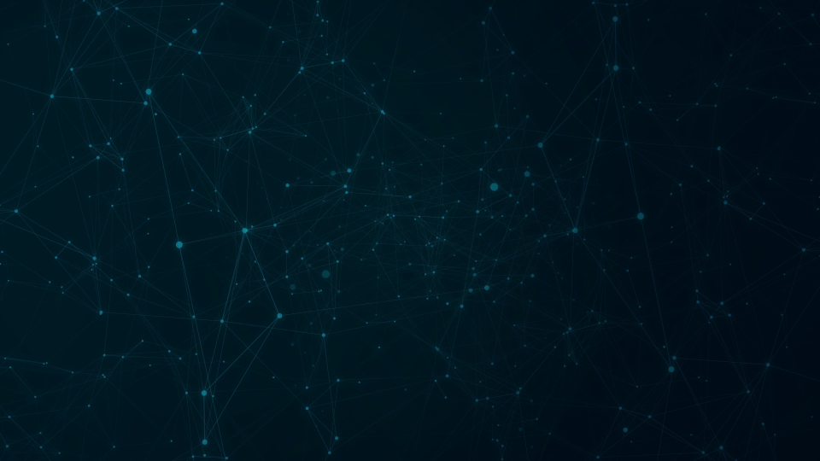
Introduction
Social media refers to a category of online platforms and applications that facilitate the creation, sharing, and exchange of user-generated content and information. These platforms allow users to interact with each other, create and share content such as text, images, videos, and audio, and build online communities around shared interests, hobbies, or causes.
Social media platforms have become increasingly popular in recent years and are now widely used across the globe. According to a 2021 report by We Are Social and Hootsuite, there are over 4.8 billion active social media users worldwide, representing more than 60% of the world's population.
The widespread adoption of social media has transformed the way people communicate, connect, and share information. Social media has become a major source of news and information, with many people using it as their primary source of information about current events, politics, and other topics. Social media has also given rise to new forms of social and political activism, with users using these platforms to organize and mobilize for social change.

Slide 3
Introduction pt.2
My research question aims to investigate the impact of social media on political discourse and engagement among diverse populations
Social media has become an increasingly important platform for political communication, with political actors using these platforms to spread false information, engage with constituents, and mobilize support. However, the impact of social media on political discourse and engagement is a subject of much debate and controversy.

Slide 4
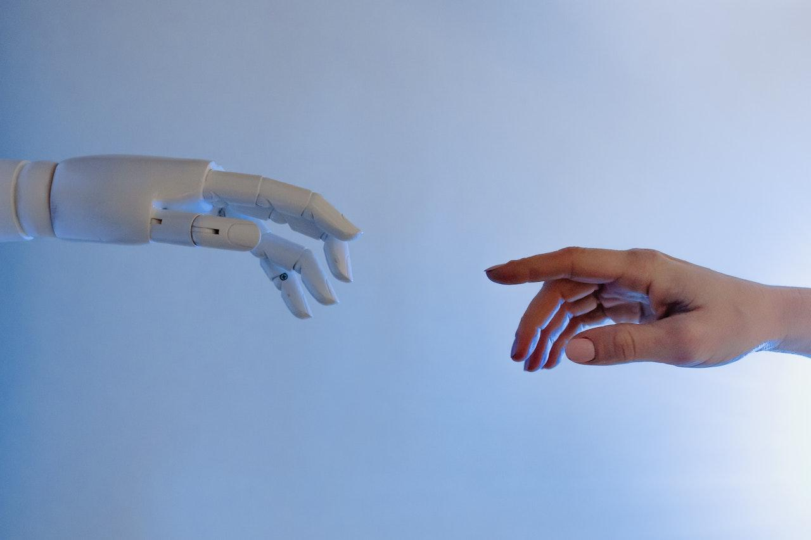
How has social media impacted politics
News website growth
Politicians on Twitter
African American Rights (BLM movement)
TikTok CEO congress hearing

Slide 5
Social media impact on News Coverage
50% of Gen Z uses social media as a daily news source
77% use it on a weekly basis
Results show that the higher the percentage of a group getting their news coverage through social media, the lesser your knowledge is on politics

Slide 6

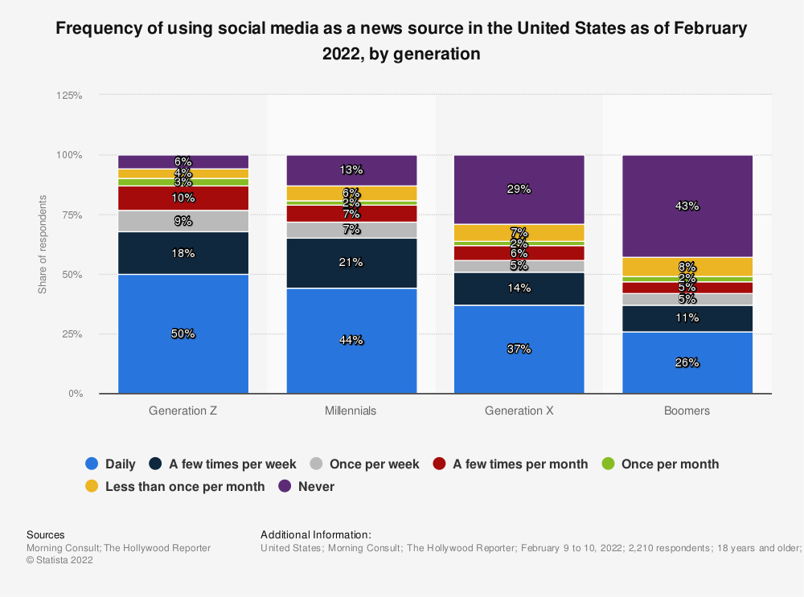

Slide 7
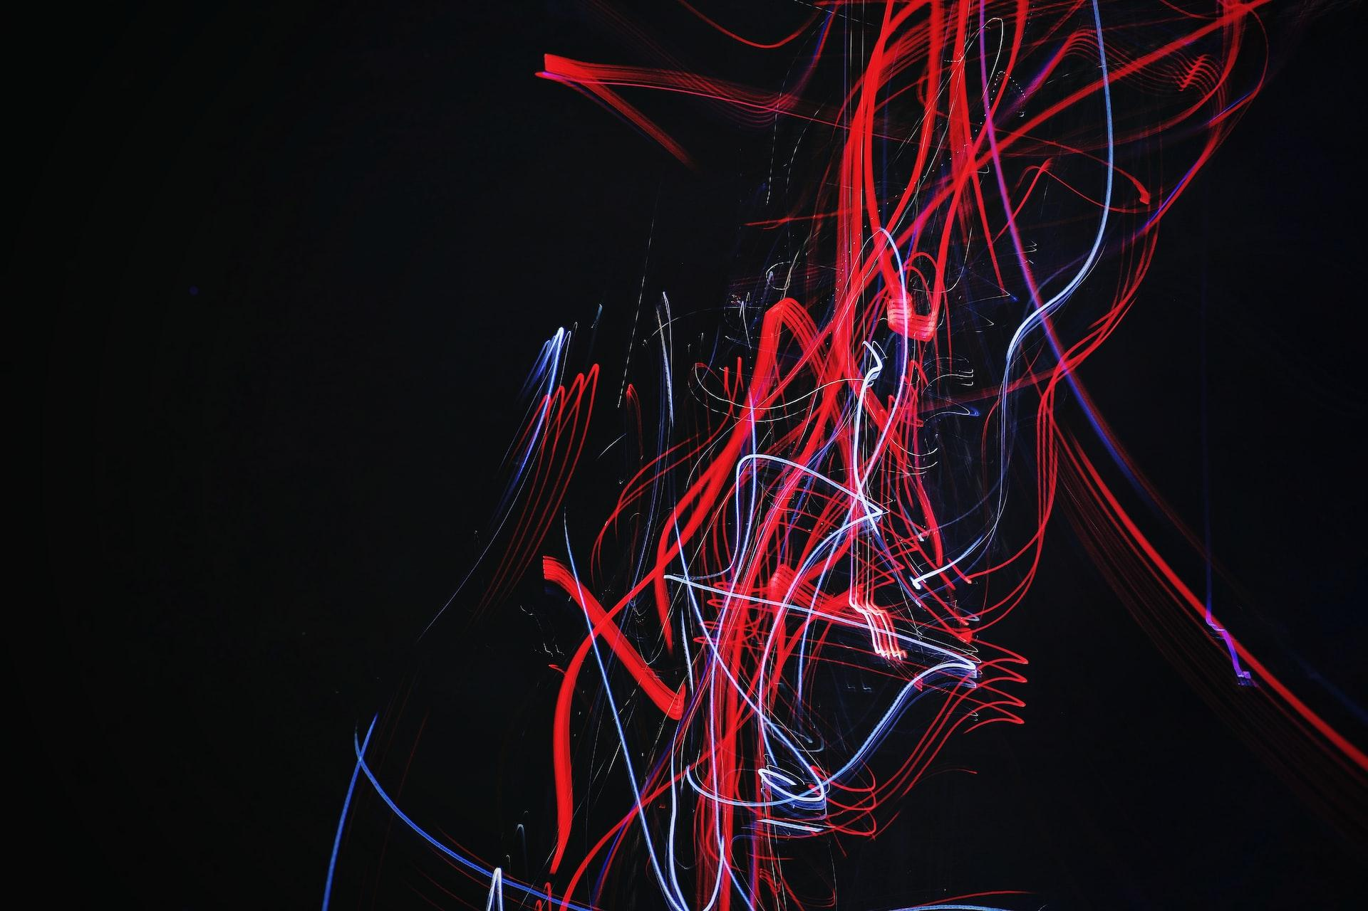
Politics on Social Media
679 Million US dollars were spent in 2022 on political digital advertising
388 million was spent through Google and Facebook
35% of U.S. adults say that participating in politics is easier through social media
In 2021, 477,586 tweets were sent out by members of the US congress in 2021 (Daily average = 1,430)

Slide 8
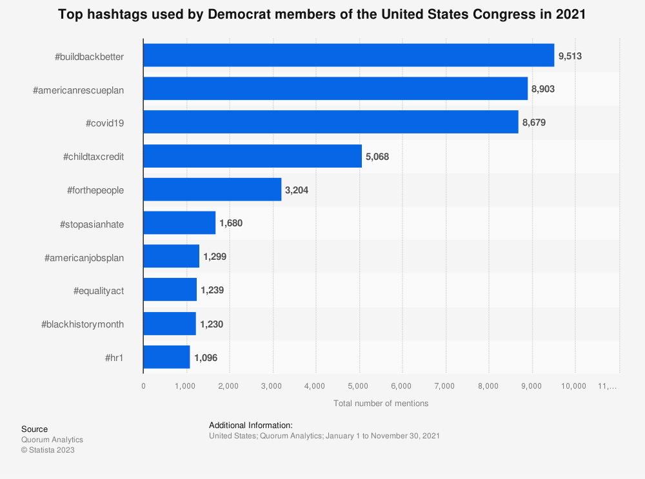

Slide 9
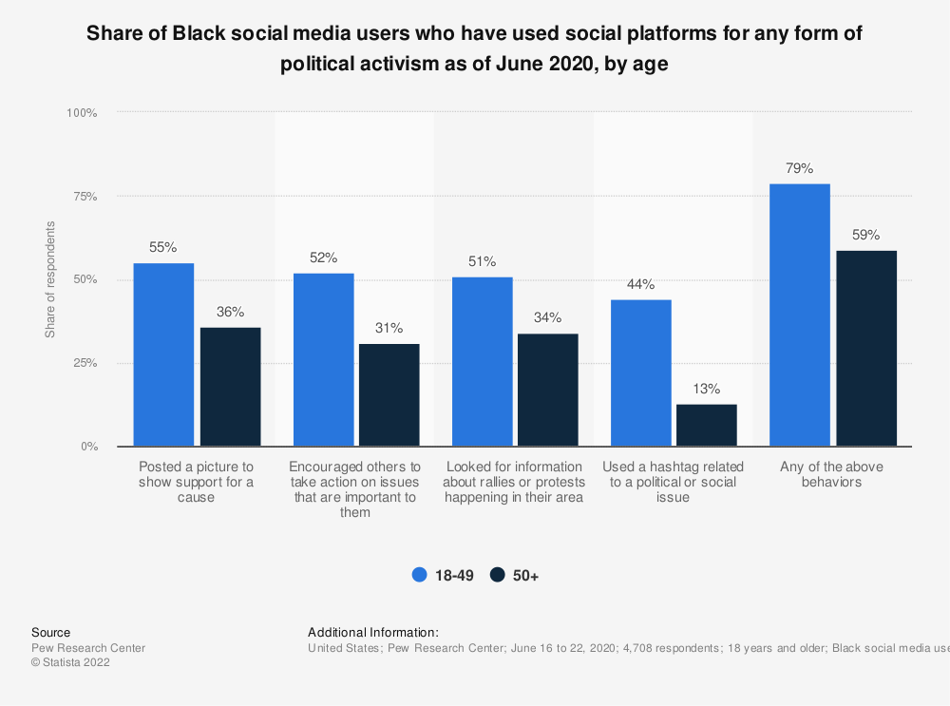
BLM Movement
.
Massive jump of social media users in the US who changed their views about a social or political issue because of something they saw on social media between 2018 and 2020
79% of African American users under the age of 50 used their platform to show support in any form of political activism in June 2020

Slide 10
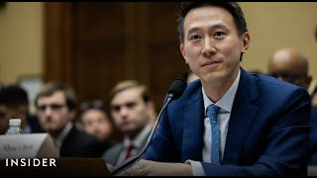
Shou Zi Chew
Shou Zi Chew is the chief executive of a new and popular social media app called TikTok. TikTok is a Chinese market app that was at first developed solely for the nation of China until a copy of the app was created for the rest of the world. Shou was recently brought before congress to be questioned as to why the app hides so much from the general population while being able to access any users private information.
ByteDance
Company that founded TiktTok and is currently under investigation for being suspected of stealing non-chinese secrets

Slide 11
Social media impact on politics
Political communication
Political mobilization
Political polarization
Misinformation

Slide 12



Ethical Considerations
Privacy
Bias
Harm
Social media data is often collected from individuals without their explicit consent. As a researcher I ensured that i complied with ethical guidelines for data privacy and protection.
Algorithms used by social media platforms have the possibility of being bias and the data collected can be a reflection of that.
In our era social media is one of the easiest ways to harm someone via hate speech and propaganda. As a researcher I made myself aware that my own findings may cause unintentional harm to be spread.

Slide 13
Resources
Maruf, Ramishah. "TikTok users are making fun of Congress members for their questions to app CEO Shou Chew." CNN, Cable News Network, 26 Mar. 2021, www.cnn.com/2021/03/26/tech/tiktok-congress-hearing-reaction/index.html.
Merkley, Lisi. "How social media impacts political views." The Conversation, 6 Aug. 2020, theconversation.com/how-social-media-impacts-political-views-143951.
Rowen-Delson, Jenna. "How Social Media Impacts Politics." Social Policy, 10 Aug. 2021, www.socialpolicy.org/how-social-media-impacts-politics/.
Jasper, Dan. "The Impact of Social Media on Politics: A Full Overview." Salsa Labs, www.salsalabs.com/blog/the-impact-of-social-media-on-politics-a-full-overview.
Maqbool, Aleem. "Black Lives Matter: From social media post to global movement." BBC News, 10 July 2020, www.bbc.com/news/world-us-canada-53232117.

Slide 14
Thank You

Slide 15

Slide Chef

